Slide 1
Samsung Innovation Campus
Artificial Intelligence Course
Notes:
Note:

Slide 2
Chapter 11.
AI Capstone Project Tutorial
AI Course
Notes:
Note:

Slide 3
Samsung Internal Use Only
Update History
Version | Update Details
v1.0 | 1st draft completed
V1.1 | Samsung, SIC logo updated
V1.11 | Chapter info. updated
Notes:
Note:

Slide 4
Chapter 11.
AI Capstone Project Tutorial
Unit 1. Using a Ready-Made CNN Model.
Unit 2. AI Application Cases.
2.1. AI based Clinical Decision Support System.
2.2. Other AI Application Cases.
Notes:
Note:

Slide 5
Unit 1. Using a Ready-Made CNN Model.
Using a Ready-Made CNN Model
Why use a ready-made model?
Building and training a deep CNN model from scratch can be quite costly (in time).
There are deep CNN models that were optimized and trained on a large dataset (*).
Reusing these ready-made models (**) to recognize new image classes can be more convenient.
We will reuse only the convolutional base that is effective in extracting generic features.
A new classification (fully connected dense) layer can be attached to adapt to the new dataset.
a). If the weights of the pre-trained convolution layers remain frozen, it’s called “fine-tuning”.
b). We can also update all the weights at once.
Notes:
Note:
(*) A commonly used dataset is that of ImageNet (http://www.image-net.org/index) that contains hundred of thousands of images.
These images are organized according to the WordNet hierarchies.
(**) Often, these models are based on optimized architectures hard to come by on our own in short time.

Slide 6
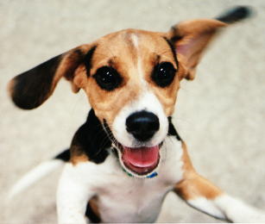
Unit 1. Using a Ready-Made CNN Model.
Using a Ready-Made CNN Model
Fine-tuning a pre-trained model:
Input
Feature Extraction
Classification
Output
Convolution layer
Pooling layer
Dropout layer
Fully connected layer
0
0
0.02
0.95
0.03
0
0
0
0
0
Repeated several times
1). Suppose a deep learning CNN model trained on a dataset.
Notes:
Note:
This diagram shows the layering structure of a convolutional neural network (CNN).

Slide 7
Unit 1. Using a Ready-Made CNN Model.
Using a Ready-Made CNN Model
Fine-tuning a pre-trained model:
Feature Extraction
Classification
Convolution layer
Pooling layer
Dropout layer
Fully connected layer
Repeated several times
2). Remove the classification layer.
Notes:
Note:
We remove the fully connected layer (classification part) leaving only the convolutional base (feature extraction part).

Slide 8
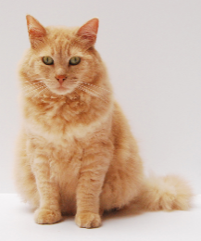
Unit 1. Using a Ready-Made CNN Model.
Using a Ready-Made CNN Model
Fine-tuning a pre-trained model:
Input
Feature Extraction
(frozen weights)
Classification
(newly trained weights)
Output
Convolution layer
Pooling layer
Dropout layer
Fully connected layer
0
0
0.02
0.05
0.03
0
0
0
0.90
0
Repeated several times
3). Train the new classification layer with a new dataset.
Notes:
Note:
We implant a new fully connected layer.
Then, have only this new part trained with a new dataset.
This fine-tuning may result in an acceptably good accuracy or may not depending on the (new) dataset.

Slide 9
Unit 1. Using a Ready-Made CNN Model.
Using a Ready-Made CNN Model
Updating all the weights at once:
Input
Feature Extraction
(newly trained weights)
Classification
(newly trained weights)
Output
Convolution layer
Pooling layer
Dropout layer
Fully connected layer
0
0
0.02
0.05
0.03
0
0
0
0.90
0
Repeated several times
4). Train the whole network all over.
Notes:
Note:
Else, we can implant a new fully connected layer and have the whole network retrained.
This would cost more time, but usually results in better performance scores.

Slide 10
Unit 1. Using a Ready-Made CNN Model.
Using a Ready-Made CNN Model
Ready-made/Pre-trained models of Keras:
Model Name | Size (MB) | Accuracy (top-1) | Parameters (in millions)
Xception | 88 | 0.790 | 23
VGG16 | 528 | 0.713 | 138
VGG19 | 549 | 0.713 | 144
ResNet, ResNetV2 | 98 ~ 232 | 0.749 ~ 0.780 | 26 ~ 60
InceptionV3 | 92 | 0.779 | 24
InceptionResNetV2 | 215 | 0.803 | 56
MobileNet | 16 | 0.703 | 4
MobileNetV2 | 14 | 0.713 | 4
DenseNet | 33 ~ 80 | 0.750 ~ 0.773 | 8 ~ 20
NASNet | 23 ~ 343 | 0.744 ~ 0.825 | 5 ~ 89
Notes:
Note:
These CNN models were trained using the ImageNet data.
“Top-1 Accuracy” is the accuracy in the usual sense.
There is another often used accuracy measure called “Top-5 Accuracy”.
Here, the prediction is scored as correct if any of the top 5 most probable labels matches with the true label.
More information can be found at:
https://keras.io/applications/

Slide 11
Unit 1. Using a Ready-Made CNN Model.
Using a Ready-Made CNN Model
A well known pre-trained model: VGG16 and VGG 19
Developed in 2014. Runner-up of the 2014 ILSVRC competition.
The default input size is 224×224.
3×3 convolution layers and 2×2 pooling layers.
Quite a large number of parameters.
Known to work well with fine tuning.
Feature Extraction
Classification
Convolution
Input
Output
Pooling
Fully connected
Dropout
Notes:
Note:
More information can be found in the original paper by the authors K. Simonyan and A. Zisserman.
https://arxiv.org/abs/1409.1556

Slide 12
Unit 1. Using a Ready-Made CNN Model.
Using a Ready-Made CNN Model
A well known pre-trained model: ResNet
Developed in 2015. Winner of the 2015 ILSVRC competition.
Shallower network that implements “residual learning”.
Non-linear layering structure with “shortcuts”.
The default input size is 224×224.
With fewer parameters than VGG achieves a higher accuracy.
Notes:
Note:
More information can be found in the original paper:
https://arxiv.org/abs/1512.03385

Slide 13
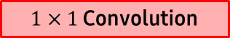

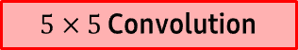

Unit 1. Using a Ready-Made CNN Model.
Using a Ready-Made CNN Model
A well known pre-trained model: InceptionV3
InceptionV1 was developed in 2014. Winner of the 2014 ILSVRC competition.
InceptionV3 is a further improved version.
Uses multiple convolution filters (different kernel sizes) concatenated in parallel.
The default input size is 299×299.
With fewer parameters than VGG achieves a higher accuracy.
Previous Layer
$1×1$ Convolution
$3×3$ Convolution
$5×5$ Convolution
$3×3$ MaxPooling
Filter Concatenation
Notes:
Note:
More information can be found in the original paper:
https://arxiv.org/abs/1409.4842

Slide 14
Unit 1. Using a Ready-Made CNN Model.
Using a Ready-Made CNN Model
How to further increase the accuracy in image classification:
1). Make sure you have a large enough training set.
⇒ If not, augment the training dataset by rotation, cropping, resizing, blurring, etc.
2). Build an ensemble or stacking model.
⇒ Combine different CNN architectures and make them “vote”.
Notes:
Note:
For image rotation, we can use the scipy.ndimage.rotate() function.
For image cropping, sub-setting the image array may work just fine.
For image resizing, we may use the cv2.resize() function for instance.
For image blurring, we may use the cv2.GaussianBlur() function for instance.
Please, also consider keras.preprocessing.image.ImageDataGenerator() function for loading and preprocessing image data.
More information can be found at:
https://keras.io/preprocessing/image/

Slide 15

Unit 1. Using a Ready-Made CNN Model.
Tutorial Example #01
Follow steps on 'tutorial_01.ipynb’ file.
Notes:
Note:

Slide 16
Chapter 11.
AI Capstone Project Tutorial
Unit 1. Using a Ready-Made CNN Model.
Unit 2. AI Application Cases.
2.1. AI based Clinical Decision Support System.
2.2. Other AI Application Cases.
Notes:
Note:

Slide 17
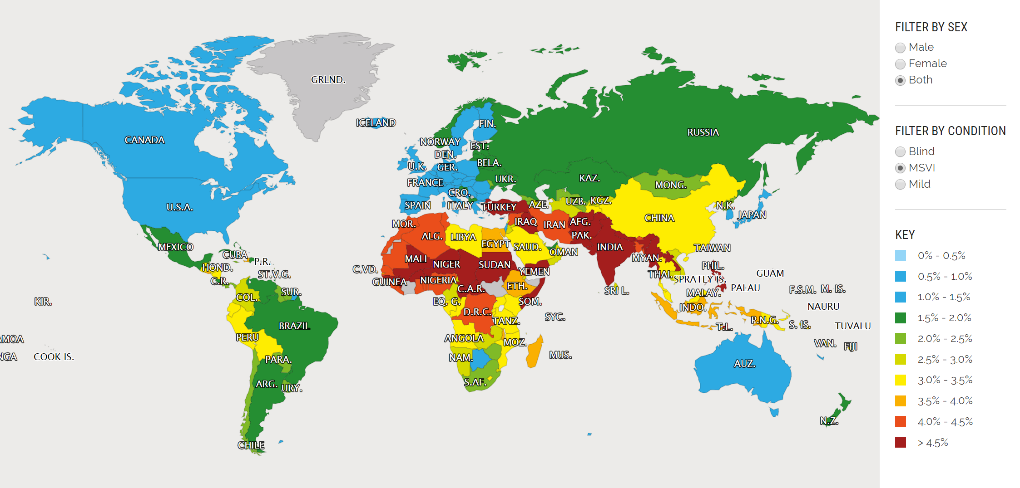
Unit 2. 2.1. AI based Clinical Decision Support System.
AI based Clinical Decision Support System
MSVI (Moderate &Severe Visual Impairment) map:
Define
Discover
Test
Analyze
Ideate& Prototype
Source: IAPB Vision Atlas, Global Vision Database Maps (http://atlas.iapb.org/gvd-maps/#AllAges)
Notes:
Note:
Of 285 million people who are visually impaired, 90% are living in developing country.

Slide 18
Unit 2. 2.1. AI based Clinical Decision Support System.
AI based Clinical Decision Support System
Causes of Visual impairment:
Define
Discover
Test
Analyze
Ideate& Prototype
Infancy
Overall
Over 50
Ophthalmia neonatorum
Retinopathy of prematurity (ROP)
0.7%
Cataract
Diabetic retinopathy Presbyopia
Glaucoma
Age-related macular degeneration (AMD)
3%
3%
4%
7%
10%
39%
Cataract
Glaucoma
Childhood & Juvenile
11%
Between 20-40
18%
Amblyopia
Strabismus
Anomalies of refraction
Etc.
Physical Injury
Cornea and Ocular disease
Anomalies of refraction with no treatment
Notes:
Note:
Over 90% of visual impairment result from chronic causes and over 80% of visual impairment could have been prevented by a proper intervention on each life stage. Timely treatment of disease can save $120m each year.

Slide 19
Unit 2. 2.1. AI based Clinical Decision Support System.
AI based Clinical Decision Support System
Vietnam:
Suitable for initiating ocular healthcare project due to the high rate of blindness and the asymmetry of accessibility in ocular healthcare by region.
High rate of mobile penetration and high-speed internet penetration, and high digital device affordability substantiate potential of expansion of the project in the country
Of the total population, 2.83% has Moderate & Severe Visual Impairment (In 2015, among 93 million people, 2.5 million were affected)
Mid-income level countries can solve cataract problem with their own capabilities. Whereas developing countries cannot afford to handle cataract, in addition to glaucoma, macular degeneration, and diabetic retinopathy.
Especially when it comes to diabetes, every one in three patients with diabetes suffer from diabetic retinopathy.
Define
Discover
Test
Analyze
Ideate& Prototype
Quang Tri
The region has lowest average income among 63 districts in the country
Poverty rate is 21.7% in 2015 (national average: 12.5%)
Low agricultural productivity due to the defoliant sprayed during the Vietnam war
Notes:
Note:

Slide 20

Unit 2. 2.1. AI based Clinical Decision Support System.
AI based Clinical Decision Support System
Why ocular health is important?
Define
Discover
Test
Analyze
Ideate& Prototype
Visual impairment decreases productivity
Poor people are more likely to be visually impaired
Vicious cycle of visual impairment and poverty
Notes:
Note:
Underprivileged people are more prone to contract a disease than other people. Visual impairment is one of the main causes of poverty, and once those who are visually impaired are recovered, they can return to economically active population and recover productivity.

Slide 21
Unit 2. 2.1. AI based Clinical Decision Support System.
AI based Clinical Decision Support System
Problem definition:
Medical service providers cannot find patients
Define
Discover
Test
Analyze
Ideate& Prototype
Medical Service Providers
Patients
Disconnected
Patients do not know how to reach out to service providers
Most important and difficult thing in preventing visual impairment is the discovery of patients.
Patients do not know whether they have ocular disease or not. Even though they do, they do not know route to get proper medical treatment.
Service provider also cannot locate where to discover untreated patients.
Thus, connecting service provider and patients is the most critical activity to break out of the vicious cycle of poverty and visual impairment.
Notes:
Note:

Slide 22


Unit 2. 2.1. AI based Clinical Decision Support System.
AI based Clinical Decision Support System
Interview (Patients):
“I am blind in one eye. I should visit Hue city which is far away from here if I want to get a diagnose. If ocular problem can be diagnosed at commune health center level, local community residents, especially elder people, will be far more benefitted than now.”
Define
Discover
Test
Ms. N (Age: 70, not a patient)
Analyze
Ideate& Prototype
“I went to commune health center because I lose visual acuity gradually. I transferred twice from commune health center to local clinic, and from the clinic to provincial hospital because they had no ophthalmoscope to diagnose. If proper diagnostic devices are equipped at commune health center level, It would be much better to provide health care service.”
Mrs. G (Age: 65, Anomalies of refraction)
“I was diagnosed with cataract at Quảng Trị Provincial Hospital, and did not take the surgery yet. When I first went to commune health center, they barely helped me. Once ophthalmoscope is equipped, chronic ocular diseases will be found and treated earlier than now. ”
Mr. N (Age: 66, not a patient)
Notes:
Note:

Slide 23

Unit 2. 2.1. AI based Clinical Decision Support System.
AI based Clinical Decision Support System
Interview (Medical Professionals):
“If ophthalmoscopes are distributed to local communities, patients will be transferred to provincial hospital at the right time, enabling them to get treatment with timely manner. This will improve ocular health of patients significantly. There are countless cases where a disease cannot be treated because it has been progressed too far.”
Define
Discover
Test
Analyze
Ideate& Prototype
Dr. D, Ophthalmologist Quảng Trị Provincial Hospital
“Most of patients come to clinic or commune health center when they feel pain in the eyes. Prior to feeling the pain, there is no one to tell them about ocular diseases. If ophthalmoscope is equipped in each commune health center, it will be more than helpful. Medical staffs can diagnose ocular diseases in early stage, thus making patients transferred to the hospital and preventing visual impairment by providing proper care.”
Dr. V, Head of Center Commune Health Center
Notes:
Note:

Slide 24
Unit 2. 2.1. AI based Clinical Decision Support System.
AI based Clinical Decision Support System
Existing ophthalmoscopes:
Define
Discover
Test
Most critical shortcoming commonly found is that those devices are all made only for OPHTHALMOLOGISTS
Making ophthalmic devices portable does not help solve the problem for ocular patients at all
Analyze
Ideate& Prototype
Organization | Research Description | Application
PEEK Vision (UK) | Photograph fundus using smartphone | Get medical specialist’s interpretation image transmission via message service
Welch Allyn (US) | Take a zoomed-in photograph with portable ophthalmic device and smartphone | Hard to focus because of the miosis and eye movement by light
Goblink (US) | Measure visual acuity, anomalies of refraction, and pupillary distance with smartphone Commercialized using portable ophthalmic device and smartphone Deliver information to optometrist and optician | Direct synchronization with smartphone is unsupported Cannot obtain information of disease other than anomalies of refraction
Horus (Taiwan) | Photograph fundus without using mydriatic Support high quality image and video Real-time screenshare via wi-fi | High retail price deters mass adoption Requires high skill-level for non-specialist doctor
Vula Eye (Switzerland) | Connect patients living in mountainous area with medical specialists Conduct visual acuity test with a simple guidance Obtain accurate and detailed information via web chat with specialists | Restricted applicability to cataract and retinal diseases which are major causes of blindness
Notes:
Note:

Slide 25

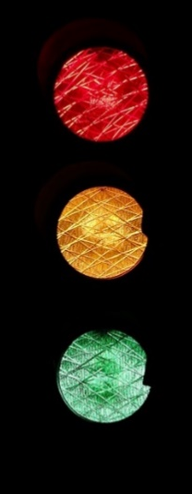
Unit 2. 2.1. AI based Clinical Decision Support System.
AI based Clinical Decision Support System
Solution:
EYELIKE: My ocular health monitor with “traffic light”
Alerting with three different colors, the device automatically “Analyze” whether medical specialist’s help is required or not and “Recommend” proper action for each color
Local medical staffs in public healthcare center can handle the device with “a minimum training”
Define
Discover
Test
Analyze
Ideate& Prototype
Notes:
Note:

Slide 26
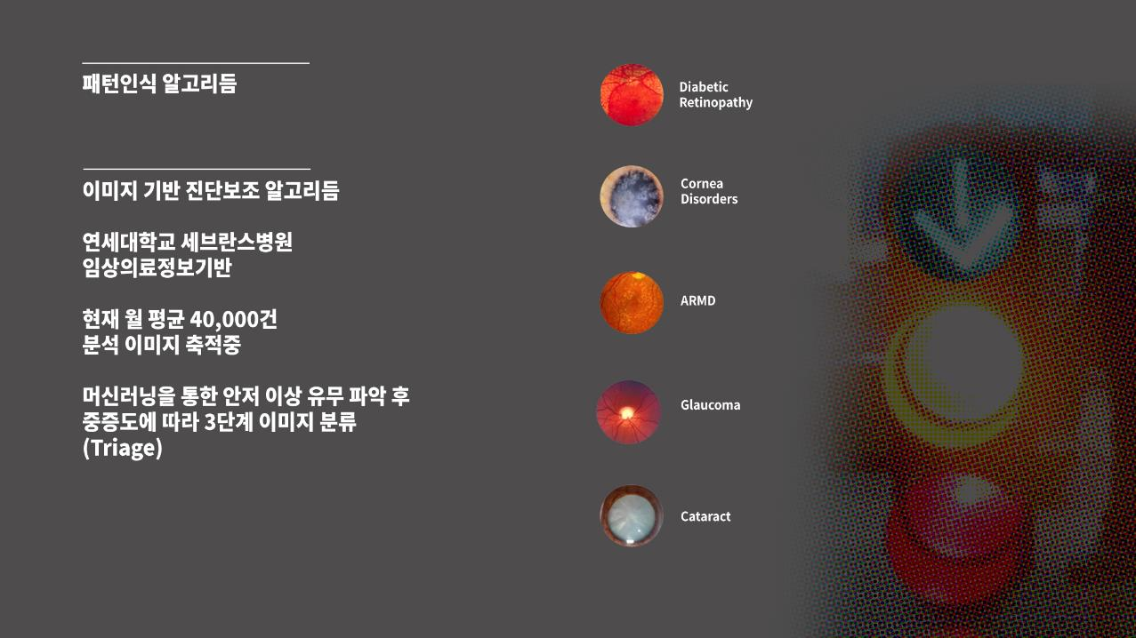
Unit 2. 2.1. AI based Clinical Decision Support System.
AI based Clinical Decision Support System
Pattern Recognition Machine Learning Algorithm:
Define
Discover
Test
Diagnosis support algorithm based on image processing
40,000 images are being accumulated per month
Detect anomaly from eye images based on Machine learning and classify the image for triage
Analyze
Ideate& Prototype
Notes:
Note:

Slide 27
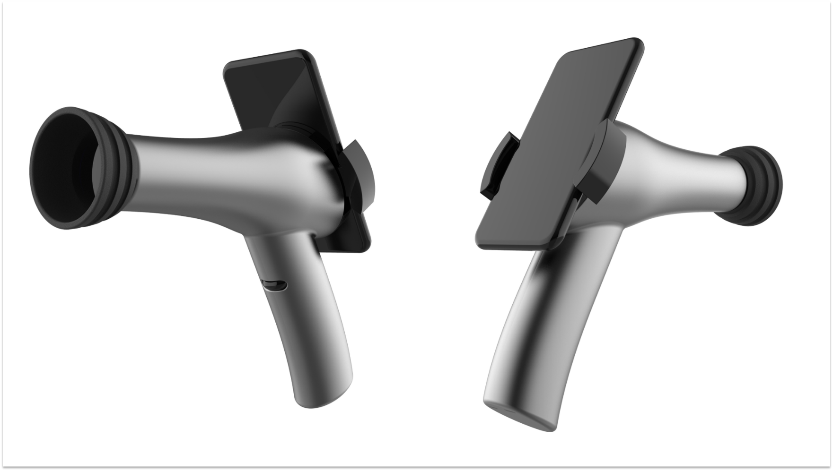
Unit 2. 2.1. AI based Clinical Decision Support System.
AI based Clinical Decision Support System
Hardware:
“Trash to treasure”
A portable, easy to use, digital ophthalmoscope at an affordable price range utilizing recycled mobile handset
Key components of the portable ophthalmoscope are an inexpensive yet high-quality camera which is a good fit for mass production and telecommunication module to connect medical specialists dispatched over a wide range of area
Without ophthalmologist training, a user can easily photograph fundus with minimum training.
Define
Discover
Test
Analyze
Ideate& Prototype
Notes:
Note:

Slide 28
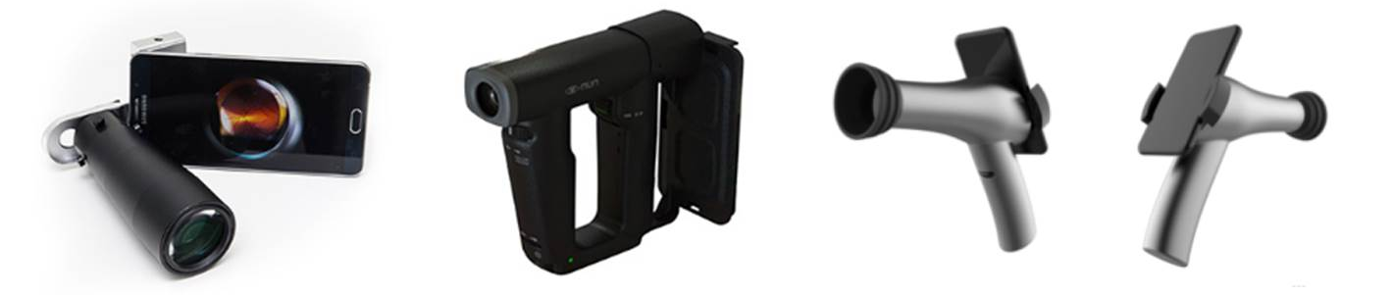
Unit 2. 2.1. AI based Clinical Decision Support System.
AI based Clinical Decision Support System
Hardware:
Define
Discover
Test
Living Lab strategy
Distributed EYELIKE digital ophthalmoscopes to 20 commune health centers in Quang Tri province and provided user training
First, project team made prototype, meet local health workers and patients, and got feedbacks
After spending one more year for discussion, the team created 2nd prototype that incorporated all stakeholder opinion in the development process, and then it was successfully implemented
This project will be expanded to another 20 commune health centers in other province
Analyze
Ideate& Prototype
2016
2017
2018
Notes:
Note:

Slide 29
Unit 2. 2.1. AI based Clinical Decision Support System.
AI based Clinical Decision Support System
Software:
Ocular health information management application based on Android OS
A web-based dashboard for the collection, analysis, and visualization of patient information
Distinguish ocular patients
Store lesion image and basic patient information
Locate residential area of the patient with GPS coordinates (Creating disease outbreak map)
Establish ocular health information system (applicable to overall public healthcare information system)
Analyze prevalence data
Define
Discover
Test
Analyze
Ideate& Prototype
Notes:
Note:

Slide 30
Tutorial 2. AI Application Cases.
AI based Clinical Decision Support System
Ocular healthcare service system:
Define
Discover
Test
Connect patients with public healthcare service provider
Utilize commune health center and its medical staffs
Task shifting with EYELIKE solution
Analyze
Ideate& Prototype
Artificial Intelligence based Clinical Decision Supporting System for blindness causing eye diseases
Improve diagnosis accuracy by providing diagnosis report function based on remote diagnosis algorithm
Cloud Server
Home
Home
Community clinic
Community clinic
Community clinic
Home
Mobile Communication Service
Provide portable ophthalmoscope and smartphone application which enable store and transmit patient information
Dispatch
Visit
Receive
Send
Public healthcare generalist
Nurturing local medical staffs to support patients who cannot visit commune health center or medical clinics.
Notes:
Note:

Slide 31
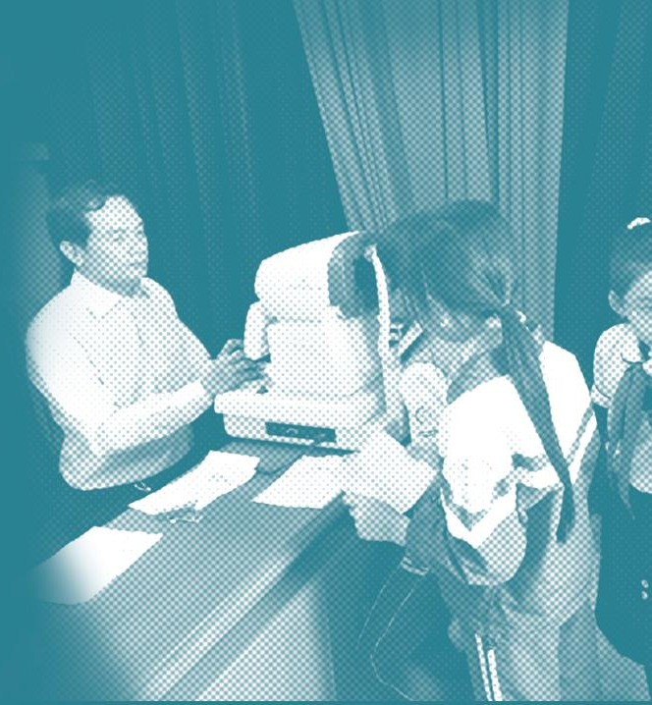
Unit 2. 2.1. AI based Clinical Decision Support System.
AI based Clinical Decision Support System
Solution Benefit Summary:
Boost ocular diagnostic capability of unskilled healthcare staffs
Create synergy effect with local ocular healthcare project which focus on treatment (Enhance efficiency and effectiveness)
Reduce the number of ophthalmologist’s initial examination and improve working environment
Reduce ocular healthcare cost in comprehensive public healthcare perspective
Provide portable digital ophthalmoscope with a significantly affordable cost (merely 1% of existing devices’ costs)
Increase blind or visually impaired population’s productivity
Accommodate blind or visually impaired population into the working-age population
Improve quality of life and lower prevalence of ocular diseases
Define
Discover
Test
Analyze
Ideate& Prototype
Notes:
Note:
Further actions to be taken
Make sure that the device is incorporated into the national health insurance policy of Vietnam
Approval would mean that patients will not be put on financial burden, and also that medical staff will not be overburdened
Plan to conduct a research on socio-economic effects of implementing EYELIKE to the communities, and the patient’s behavioral changes occurred by improved healthcare access

Slide 32
Chapter 11.
Capstone Project Guide
AI Capstone Project Tutorial
Unit 1. Using a Ready-Made CNN Model.
Unit 2. AI Application Cases.
2.1. AI based Clinical Decision Support System.
2.2. Other AI Application Cases.
Notes:
Note:

Slide 33
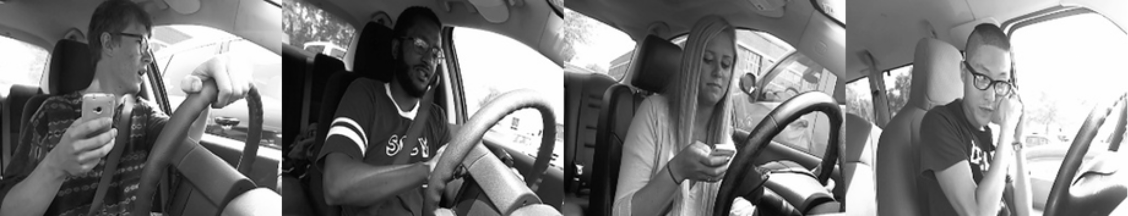
Unit 2. 2.2. Other AI Application Cases.
AI Application Cases
Case #1: Distracted driver detection.
Context
Challenging Fact
Approach
According to a recent data, one in five car accidents is caused by a distracted driver.
Can dashboard cameras automatically detect drivers engaging in distracted behaviors? (**)
It is very costly both in time and computing resources to build and train an image classification model from scratch.
There might be outliers that are hard to classify.
Classify the images by fine-tuning a ready-made CNN model or by retraining it all over. (***)
Distracted?
Notes:
Note:
More information can be found at Kaggle:
https://www.kaggle.com/c/state-farm-distracted-driver-detection
(**) There are 10 driver states:
0: safe driving
1: texting – right
2: talking on the phone – right
3: texting – left
4: talking on the phone – left
5: operating the radio
6: drinking
7: reaching behind
8: hair and makeup
9: talking to passenger
(***) By retraining the whole network instead of just “fine-tuning”, we may achieve a higher accuracy.

Slide 34
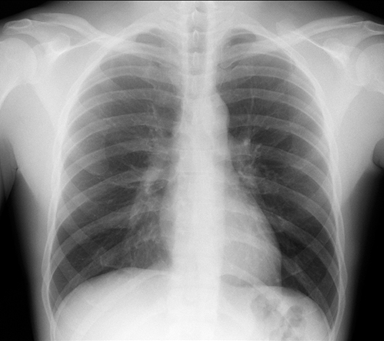
Unit 2. 2.2. Other AI Application Cases.
AI Application Cases
Case #2: RSNA pneumonia detection (*).
Context
Challenging Fact
Approach
Can an AI algorithm detect accurately the patterns of pneumonia in a chest X-ray image?
It is very costly both in time and computing resources to build and train an image classification model from scratch.
Classify the images by fine-tuning a ready-made CNN model or by retraining it all over. (**)
Healthy or else?
Notes:
Note:
(*) RSNA is an international society of radiologists, medical physicists and other medical professionals.
(**) By retraining the whole network instead of just “fine-tuning”, we may achieve a higher accuracy.
More information can be found at Kaggle:
https://www.kaggle.com/c/rsna-pneumonia-detection-challenge

Slide 35
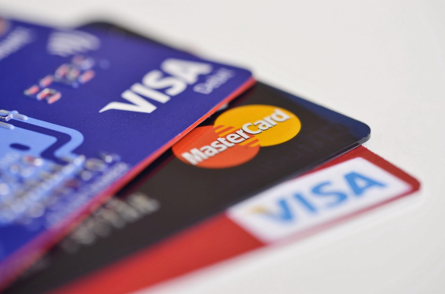
Unit 2. 2.2. Other AI Application Cases.
AI Application Cases
Case #3: Credit card fraud detection.
Context
Challenging Fact
Approach
Detecting credit card fraud is important in order to protect the real holders.
The dataset is highly unbalanced only with approximately 0.2% frauds (*).
The dataset has been transformed by PCA (**).
It is necessary to explore the dataset in search of patterns using “clever” and “intuitive” ways.
Rather than deep learning, a relatively “simpler” machine learning algorithm may suffice. For example, XGBoost.
Fraudulent transaction?
Notes:
Note:
More information can be found at Kaggle:
https://www.kaggle.com/mlg-ulb/creditcardfraud
(*) Using accuracy to measure the classification performance does not make sense any more.
Declaring all cases as non-fraudulent will give 99.8% accuracy right away, although this will miss out all the truly fraudulent cases that actually matter.
It is suggested to use the area under the precision-recall curve (AUPRC) as the performance measure.
(*) For properly training an unbalanced dataset, we can apply one the following methods:
1). Under-sample the dominant class.
2). Over-sample the rare class.
3). Use a resampling method called SMOTE(Synthetic Minority Over-sampling Technique).
The effectiveness of these methods is yet to be tested in this particular problem (please, try it yourself!)
(**) The features are named “V1”, “V2”, … which do not give “intuitive” meanings any more.
The only features that retain the true names are “time” and “amount”.
This fact complicates the exploratory analysis.

Slide 36

Unit 2. 2.2. Other AI Application Cases.
AI Application Cases
Case #4: Identifying fake news.
Context
Challenging Fact
Approach
Fake news undermines serious media coverage and makes it more difficult for journalists to cover significant news stories.
Can an AI algorithm reliably detect fake news articles?
Finding patterns in a text data is always non-trivial.
Unlike spams, fake news articles can be better disguised and harder to tell apart.
The text data should be cleaned and normalized carefully.
Use both supervised and unsupervised learning to detect likely patterns (*).
Yet, another fake news?
Notes:
Note:
More information can be found at Kaggle:
https://www.kaggle.com/c/fake-news
(*) The first approach would be to follow the standard natural language processing (NLP) methodology.
Clean and normalize the data.
Represent the news articles as a TF-IDF matrix.
Apply unsupervised learning (such as topic modeling, DBSCAN, k-means, etc.) to detect a hidden structure (if any).
Carry out the classification analysis (supervised learning).
OR
It is also suggested to try LSTM network with embedding representation of the features.

Slide 37

End of
Document
Samsung Innovation Campus

